Slide 1
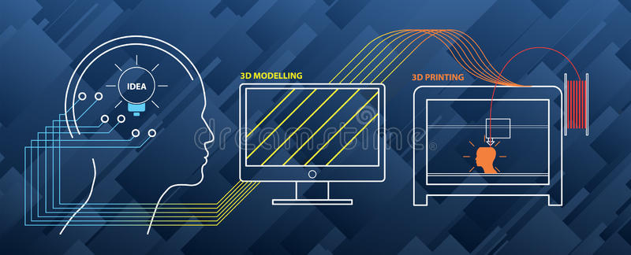
3D PRINTING

Slide 2

QUESTION:
What is 3D Printing?

Slide 3
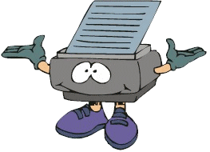
3D printing(also known as additive manufacturing) is the construction of a three-dimensional object from a digital design

Slide 4
HISTORY
Charles Hull invented 3D printing between 1984-86
In 1999 human bladder was created using 3D printing. This is the first application of 3D printing in medical field
In 2011 , 3D printers start offering 14k gold as printable material

Slide 5

How does it work????

Slide 6
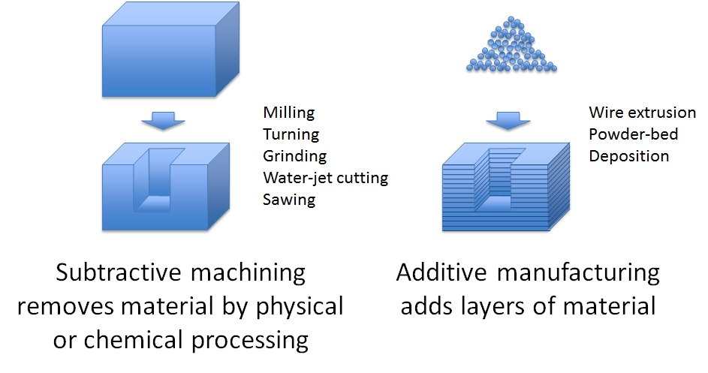
Terminology
Additive Manufacturing
Rapid Prototyping
Subtractive Process
Stereolithography

Slide 7
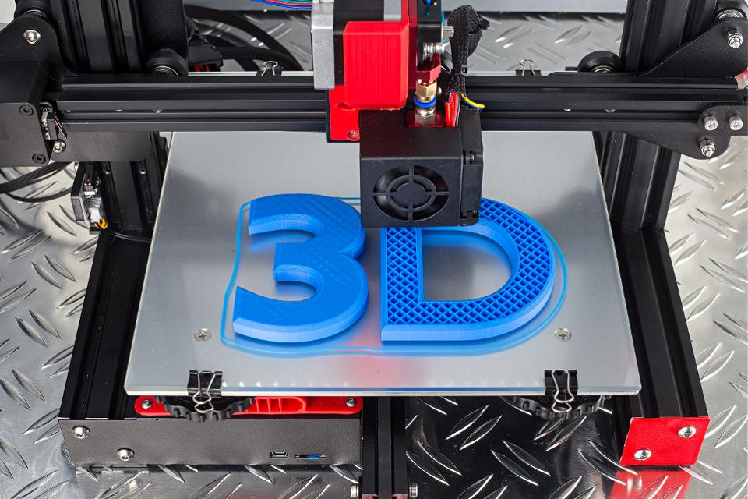
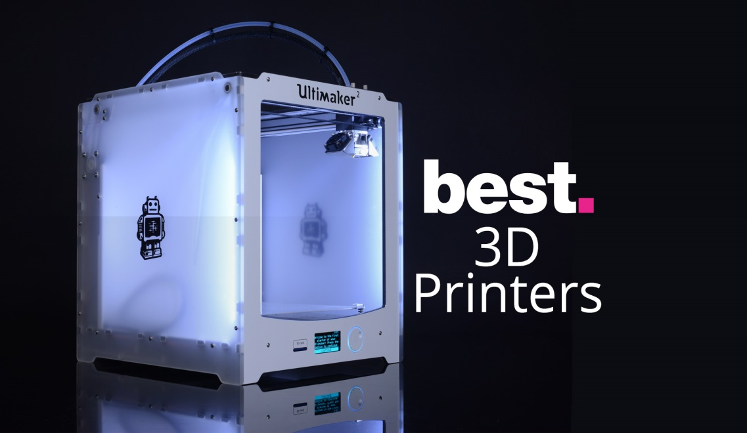
3D Printable Models
3D printable models are created with a design package or via 3D scanner

Slide 8
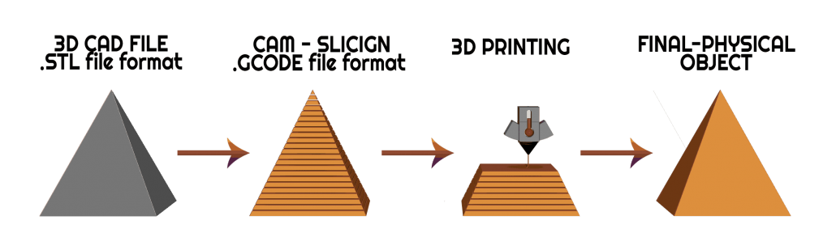

Printing
To perform a print , the machine reads the design from a 3D printable file (STL file)
Printer resolution describes layer thickness and X-Y resolution in d pi (dots per inch) or micrometres
The particles(3D dots)are around 50 to 100 $μm$ (50-250 d pi) in diameters.

Slide 9
Additive Process
Extrusion deposition
Granular material binding
Lamination
Photo polymerization
Mask-image-projection-based stereolithography

Slide 10
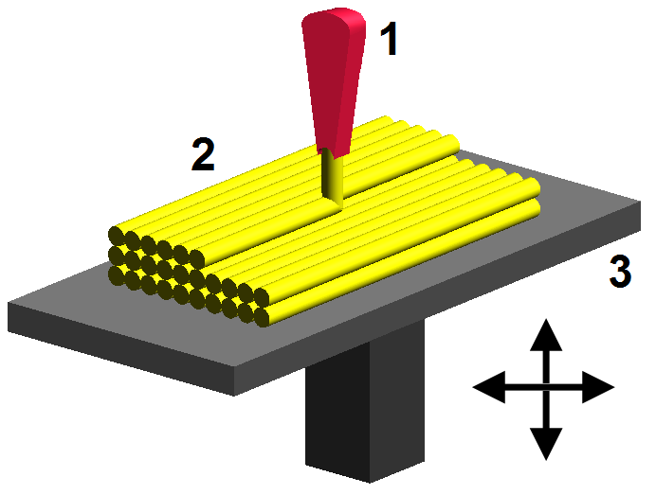
Extrusion deposition
Additive manufacturing technology commonly used for modelling , prototyping , and production applications
Polymers used = ABS , PC ,PLA etc.

Slide 11
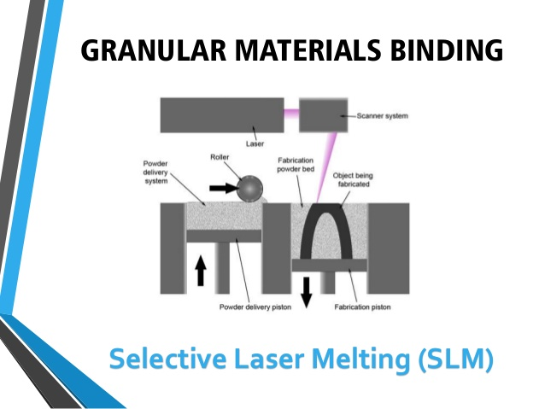
Granular material binding
The granular binding process involves fusing different layers of granules in a repeat process in order to build the desired object

Slide 12
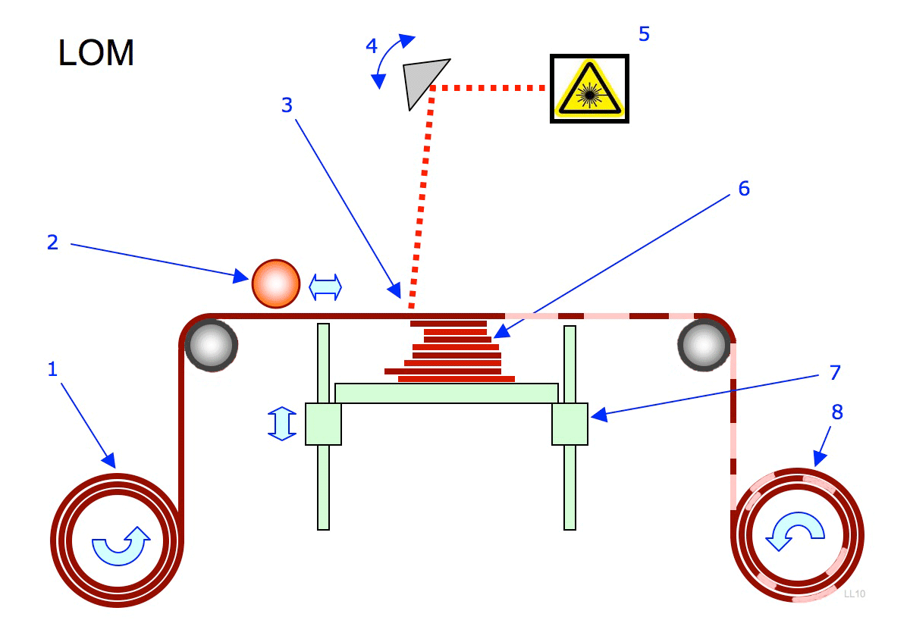
Lamination
In this process layers of plastic or paper are fused — or laminated — together using heat and pressure, and then cut into the desired shape with a computer-controlled laser or blade.

Slide 13
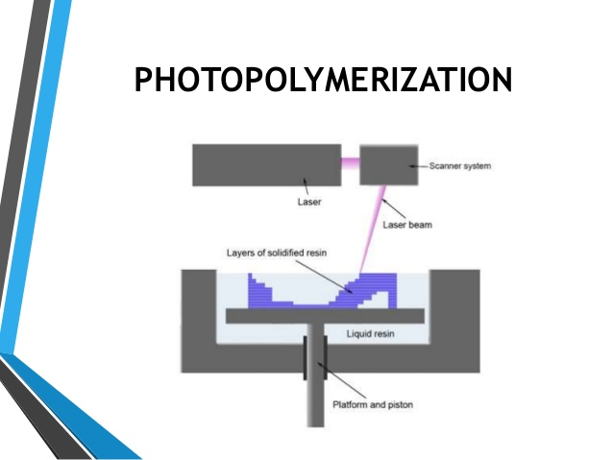
Photopolymerization
This process is primarily used in stereolithography to produce a solid part from a liquid

Slide 14
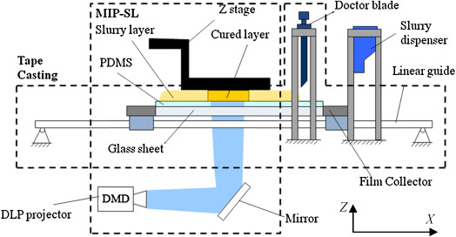
Mask image projection based on stereolithography
A 3D digital model is sliced by a set of horizontal planes. Each slice is converted into 2D mask image which is projected onto a photocurable liquid resin surface. Finally light is projected onto the resin to cure it in the shape of the layer.

Slide 15
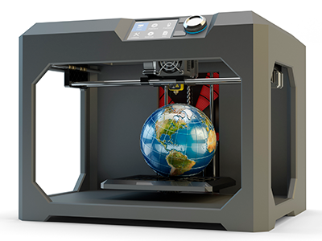
Finishing
Though the printer-produced resolution is sufficient for many applications , printing a slightly oversized version of the desired object in standard resolution and then removing material with a higher resolution subtractive process can achieve greater precision

Slide 16
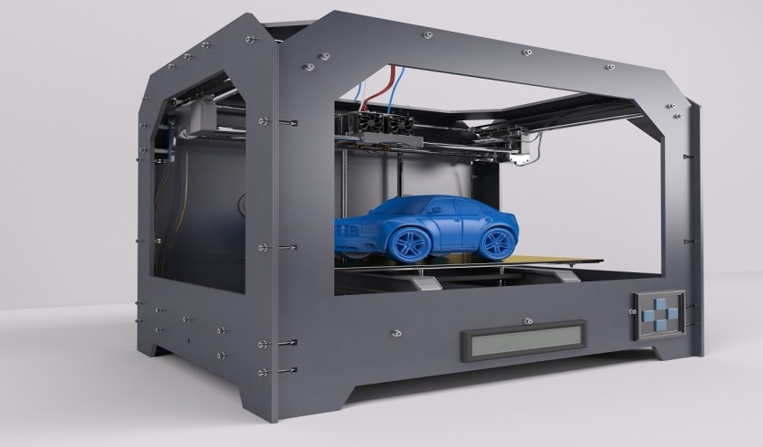
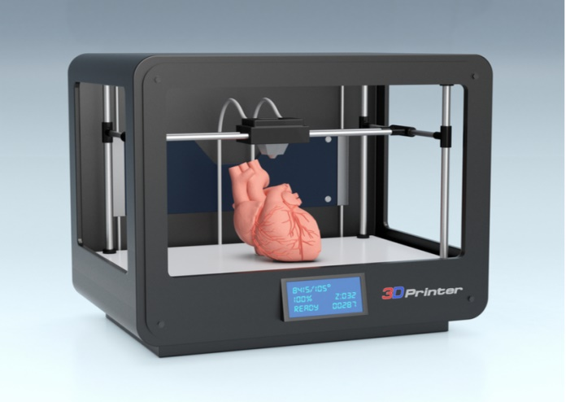
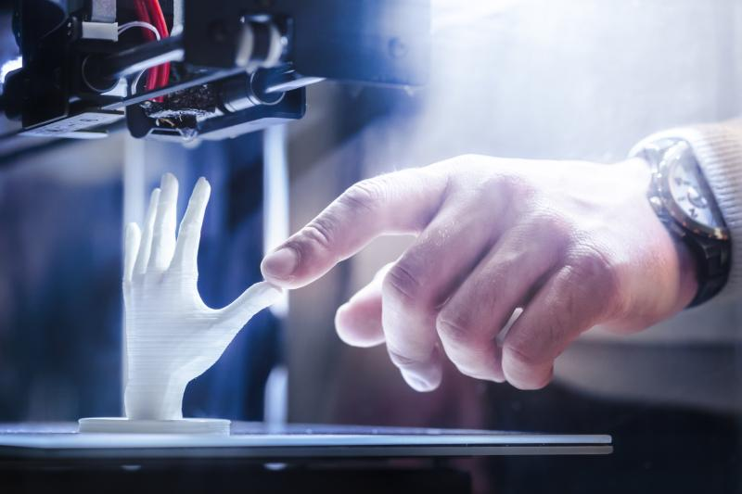
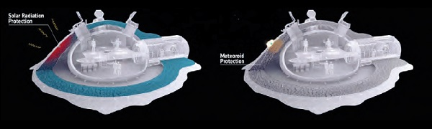
Applications
For industrial purposes
For 3D bio printing
Printing for implant and medical device
For space exploration

Slide 17

ADVANTAGES AND DISADVANTAGES

Slide 18

ADVANTAGES
Quickly capture physical measurements of any physical object
Save time in design work
Ensure parts will fit together on the first try
The printed parts are strong and light weight

Slide 19

DISADVANTAGES
Nearly anything can be printed by 3D printers and this is troubling prospects
Firearms could be downloaded and reproduced by anybody with a 3D printer
Potential reduction in human labour
As 3D printing is becoming more popular and accessible there is a greater possibility for people to create fake and counterfeit products and it will almost be impossible to tell the difference.

Slide 20
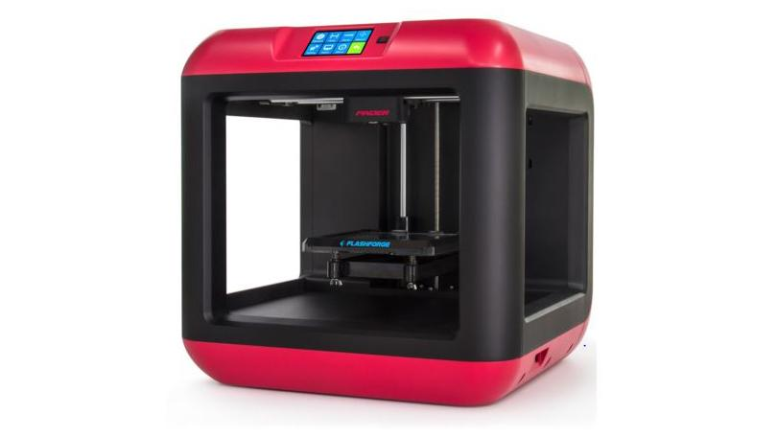
CONCLUSION
3D printing technology could revolutionize and re-shape the world. Advances in 3D printing technology can significantly change and improve the way we manufacture products and produce good worldwide

Slide 21


Slide 22

If you have any question related to this topic , you can ask

